Slide 1

Introduction TO MICROCONTROLLERS and MICROCOMPUTERS
LECTURE-3

Slide 2
MicroCOntrollers
Microcontrollers are integral part of embedded systems. A microcontroller is basically cheap and small controller on a single chip that comprises a processor, a small memory, and programmable input-output peripherals. They are meant to be used in automatically controlled products and devices to perform predefined and pre-programmed tasks.

Slide 3
Example
A digital thermometer that displays the ambient temperature uses a microcontroller which is connected to a temperature sensor and a display unit (like LCD). The microcontroller here takes the input from temperature sensor in raw form, process it and display it to a small LCD display unit in a human readable form.

Slide 4
Common Microcontrollers in the market
Atmel (ATTiny, ATMega,AVR32 etc.)
Phillips/NXP Semiconductors (P87C591, P89C51RD etc.)
Intel (MCS-48,MCS-51,MCS-151 etc.)
Microchip Technology (PIC24, PIC32, PIC16etc)
Silicon Laboratories (C8051, ARM Cortex M3/M4/M0+)
STM Microelectronics (ST6, ST7, ARM Cortex (STM32))
Texas Instruments (TMS370, MSP430)

Slide 5
MICROPROCESSORS
A microprocessor is a computer processor that incorporates the functions of a central processing unit on a single integrated circuit (IC), or at most a few integrated circuits. The microprocessor is a multipurpose, clock driven, digital integrated circuit that accepts binary data as input, processes it according to instructions stored in its memory and provides results as output. Microprocessors contain both combinational logic and sequential digital logic. Microprocessors operate on numbers and symbols represented in the binary number system.

Slide 6
Examples
Many items that were traditionally not computer-related include microprocessors. These include:
Large and small household appliances.
Cars and their accessory equipment.
Tools and test instruments, toys.
Light switches/dimmers and electrical circuit breakers, smoke alarms, battery packs, and hi-fi audio/visual components (from DVD players to phonograph turntables).
Cellular telephones.
DVD video system and HDTV broadcast systems fundamentally which require consumer devices with powerful, low-cost, microprocessors.

Slide 7
Common Microprocessors
Intel (8086, 8088, Pentium, Core, Xeon etc.)
AMD (PRO-A, AM2900 Series, K8/10, etc.)
Motorola (PowerPC700, 6800,6809)
HP (FOCUS, PA-7000/7200/8500/8900)
Acer (Ryzen5, Ryzen7)

Slide 8
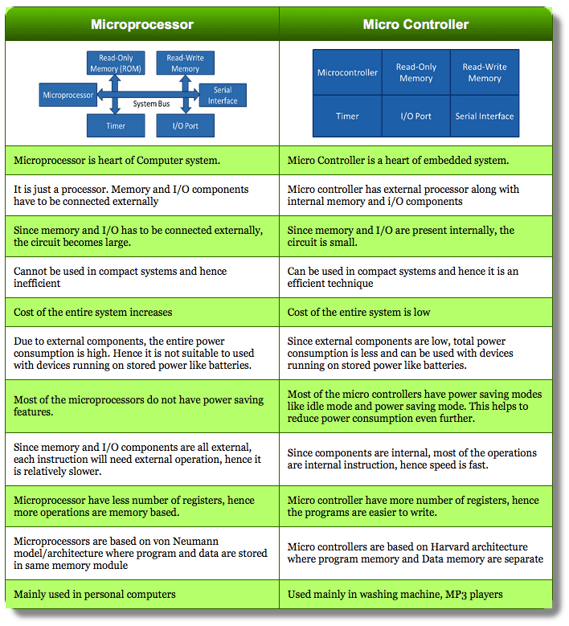

Slide 9
Microcomputers
A microcomputer is a small, relatively inexpensive computer with a microprocessor as its central processing unit (CPU). It includes a microprocessor, memory, and minimal input/output (I/O) circuitry mounted on a single printed circuit board(PCB). Microcomputers became popular in the 1970s and 1980s with the advent of increasingly powerful microprocessors. The predecessors to these computers, mainframes and minicomputers, were comparatively much larger and more expensive. Many microcomputers (when equipped with a keyboard and screen for input and output) are also personal computers (in the generic sense).

Slide 10
Examples
Modern desktop computers (PCs).
Video game consoles.
Laptops.
Mobile Phones.
Smartphones.
Tablets.
Pocket/Scientific Calculators.

Slide 11
Introduction to NOdeMCU
NodeMCU is an open source IoT platform. It includes firmware which runs on the ESP8266 Wi-Fi SoC from Espressif Systems, and hardware which is based on the ESP-12 module. NodeMCU is programmed using Arduino IDE.
Simple ESP8266 can only be used to connect other micro-controllers like Arduino to internet with its inbuilt wifi chip. But with NodeMCU development kit this hardware module can use its GPIO pins to connect to other peripherals without help of any other micro-controller.

Slide 12
Nodemcu Hardware
ESP8266 : It is main chip with inbuilt wiFi
USB to UART convertor : This chip will convert USB data to UART data which main chip can understand
Voltage regulators.
Status LED : This LED is basically used to show current status like flashing/booting
MicroUSB port : Connect board to Computer for programming and powering the board.
Reset/Flash buttons : Perform actions on board.
GPIO pins : To connect board with other peripherals.

Slide 13
ESP8266
The ESP8266 is a low-cost Wi-Fi microchip (SoC) with full microcontroller capability produced by Espressif Systems, a fabless semiconductor company operating out of Shanghai, China.

Slide 14
ESP8266 Features
32-bit Tensilica microcontroller.
RF capability.
Power amplifier, low noise receive amplifier,
2.4 GHz Wi-Fi (802.11 b/g/n).
General-purpose input/output (16 GPIO)
One Analog-to-digital converter (10-bit ADC).
UART (on dedicated pins, plus a transmit-only UART can be enabled on GPIO2).
Pulse-width modulation (PWM).
Tensilica's Diamond Standard 106Micro 32-bit processor controller core and runs at 80 MHz (or overclocked to 160 MHz).
64 KiB boot ROM, 32 KiB instruction RAM, and 80 KiB user data RAM. (Also, 32 KiB instruction cache RAM and 16 KiB ETS system data RAM.)
The silicon chip itself is housed within a 5 mm × 5 mm Quad Flat No-Leads package with 33 connection pads — 8 pads along each side and one large thermal/ground pad in the center.

Slide 15
ESP32
ESP32 is a series of low-cost, low-power IoT Platform (SOC) microcontrollers with integrated Wi-Fi and dual-mode Bluetooth, it comes in both dual-core and single-core variations.

Slide 16
ESP32 Features
Xtensa dual-core (or single-core) 32-bit LX6 microprocessor, operating at 160 or 240 MHz.
520 KiB SRAM
Wi-Fi 802.11 b/g/n and Bluetooth v4.2 BR/EDR and BLE.
12-bit SAR ADC up to 18 channels
2 × 8-bit DACs
10 × touch sensors (capacitive sensing GPIOs)
3 × UART
Ethernet MAC interface
Infrared remote controller (TX/RX, up to 8 channels)
Motor PWM
LED PWM (up to 16 channels)
Hall effect sensor
Ultra low power analog pre-amplifier

Slide 17
Raspberry Pi
Raspberry Pi is the name of a series of single-board computers made by the Raspberry Pi Foundation, a UK charity that aims to educate people in computing and create easier access to computing education.
The Raspberry Pi launched in 2012, and there have been several iterations and variations released since then. The Raspberry Pi 4 is the latest product in the Raspberry Pi range.

Slide 18
Raspberry Pi Features
Broadcom BCM2837B0, Cortex-A53 (ARMv8) 64-bit SoC @ 1.4GHz
1GB LPDDR2 SDRAM
2.4GHz and 5GHz IEEE 802.11.b/g/n/ac wireless LAN, Bluetooth 4.2, BLE
Gigabit Ethernet over USB 2.0 (maximum throughput 300 Mbps)
Extended 40-pin GPIO header
Full-size HDMI
4 USB 2.0 ports
CSI camera port for connecting a Raspberry Pi camera
DSI display port for connecting a Raspberry Pi touchscreen display
4-pole stereo output and composite video port
Micro SD port for loading your operating system and storing data

